Slide 1

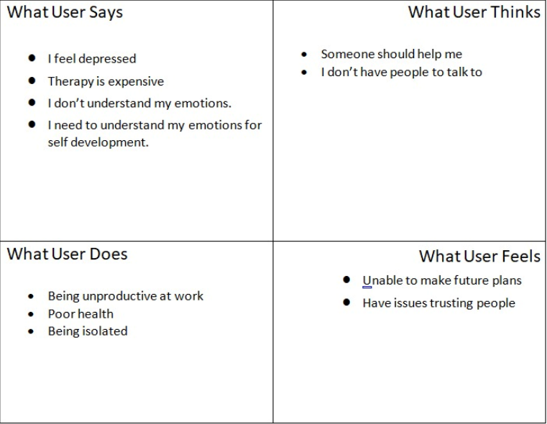
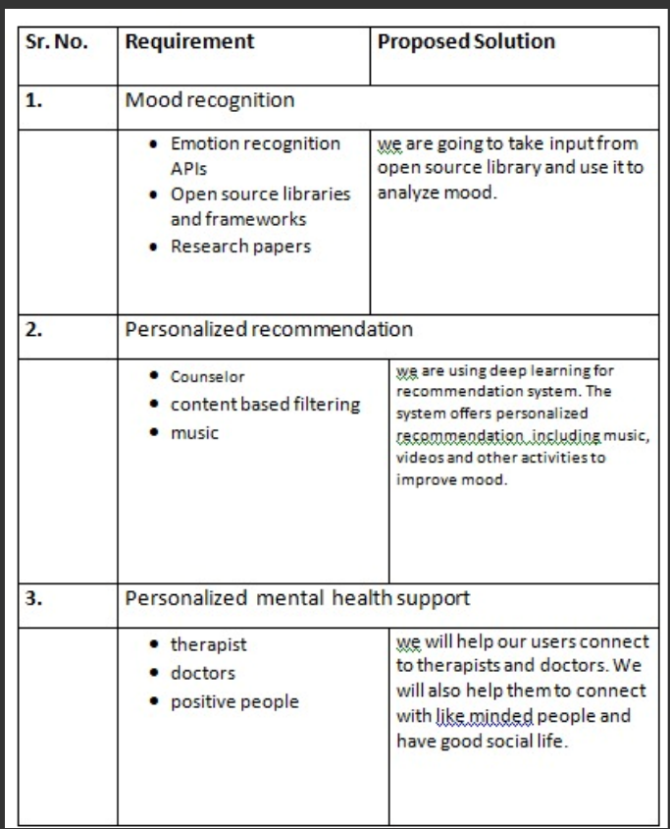
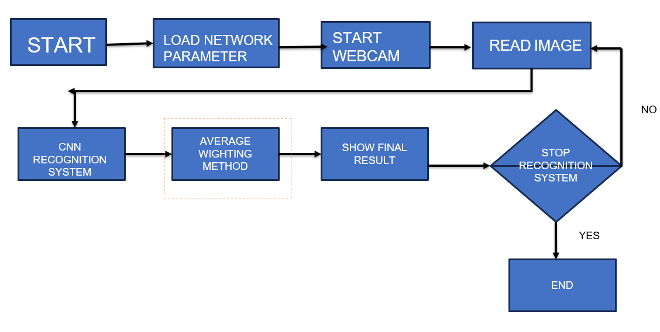
Proposed Architecture/ Diagram:
MIT SCHOOL OF COMPUTING
Class : TYCORE1
Group Id: 19
DEPARTMENT OF COMPUTER SCIENCE & ENGINEERING
AI based methodology to predict emotion using facial expressions
Mayank Modi, Jayesh Mathur, Ritwick Prabhat, Himanshu Gujrathi
Faculty Guide:
Dr. Anupama Budhewar
User
Problem statement
Create a platform for managing academic fests, enabling event discovery, enrollment, proposal approval, and volunteer coordination with authority oversight.
Proposed Solution
Develop an emotion prediction system using a pre-trained CNN model that analyzes facial expressions from recognized face. Train the model on a labeled dataset of diverse emotions, then deploy it as a user-friendly web application to provide real-time emotion predictions from recognized face. Regular updates and user feedback will ensure continuous improvement and accuracy.
Scope and Feasibility
developing a system to recognize and analyze human moods, likely utilizing facial expressions, voice tone, and possibly other cues. It could have applications in fields like mental health, human-computer interaction, and more. It is already being used in cognitive psychology, clinical diagnostics, EEG(electroencephalography).

